Slide 1
Does Age Impact Success in Motorsports?
Tess Hinkle
Department of Mathematics and Statistics
Murray State University

Slide 2
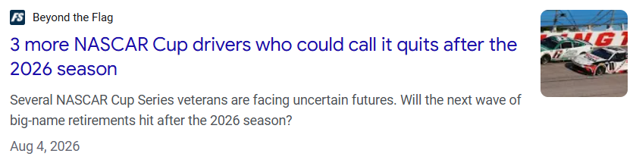
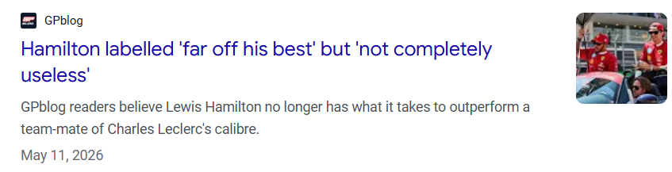
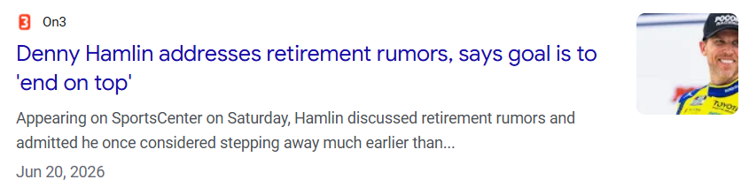
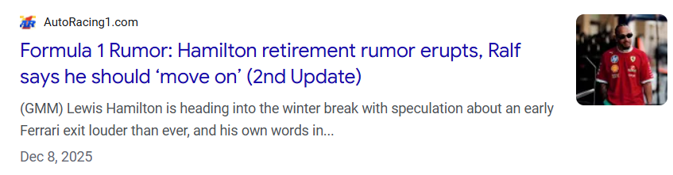
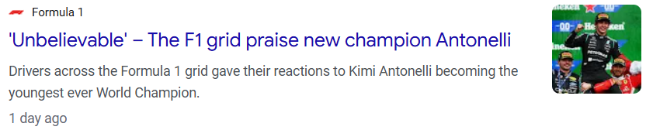
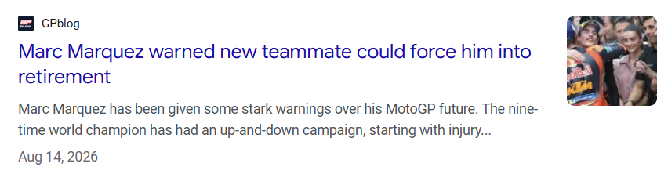
Age is a common topic of a driver’s success and overall career

Slide 3
Data
Data collected from 2016-2025
Covering 3 unique motorsports: Formula One, NASCAR, MotoGP
F1 data was acquired through the f1dataR package
NASCAR data was acquired through nascaR.data package and some manual data entry
MotoGP data was acquired through a publicly available API

Slide 4
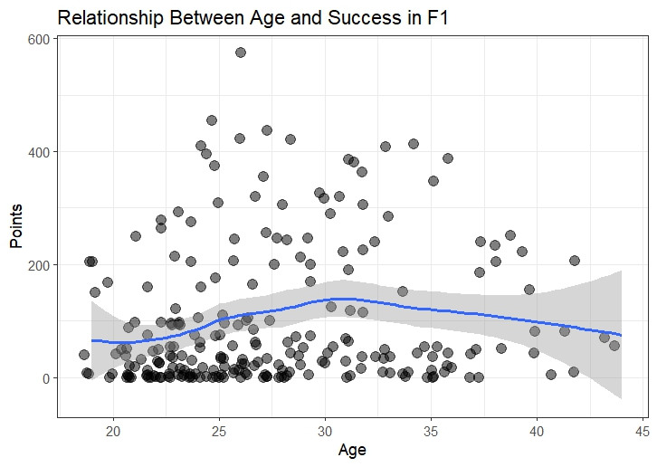
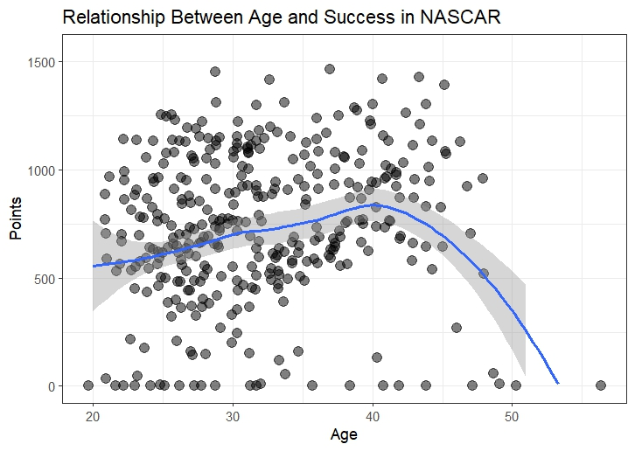
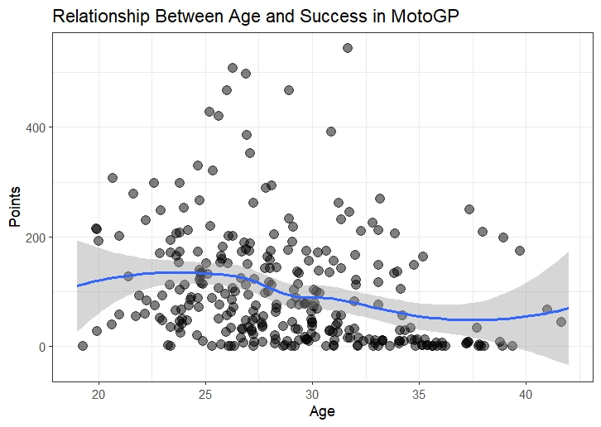
Initial plotting shows a non-linear effect

Slide 5
Generalized Additive Model without Team Effects
u(Driver): random intercept for each unique driver
f(Age): smooth function modeling the non-linear effect of the driver’s age
f(Years): smooth function modeling the non-linear effect of years spent with the team

Slide 6
Generalized Additive Model with Team Effects
u(Driver): random intercept for each unique driver
v(Team Group): random intercept for each unique team group
f(Age): smooth function modeling the non-linear effect of the driver’s age
f(Years): smooth function modeling the non-linear effect of years spent with the team

Slide 7
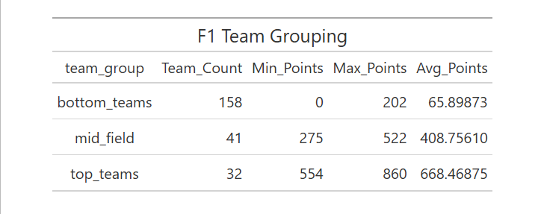
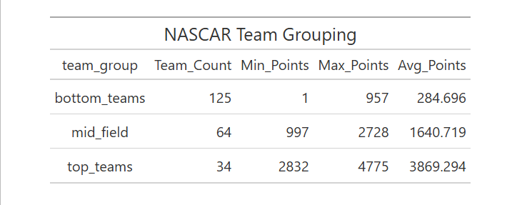
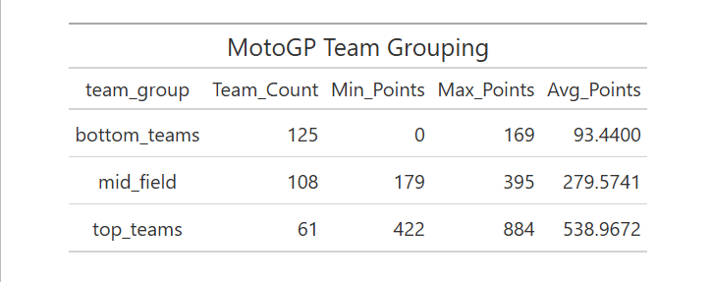
Clustering Analysis for Team Effect

Slide 8
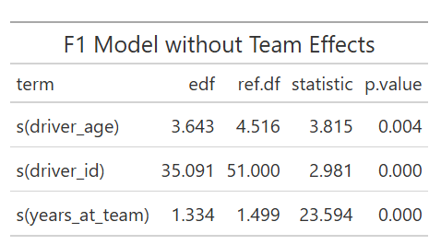
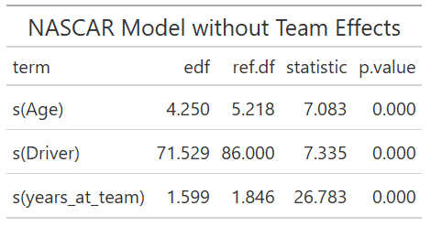
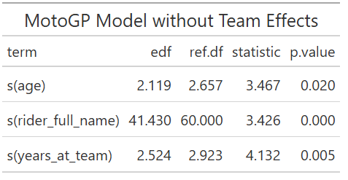
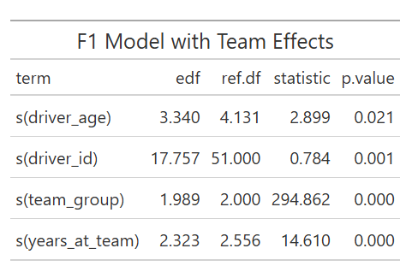
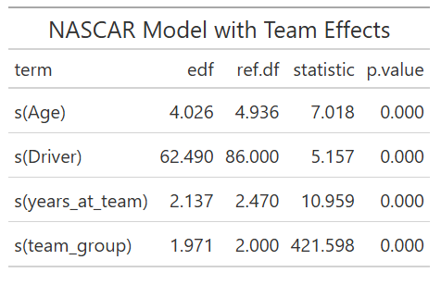
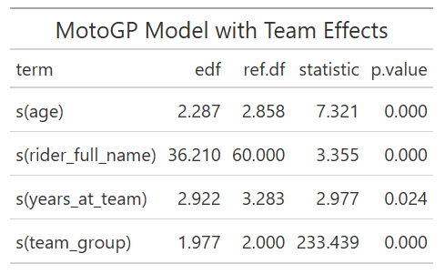
Model Results

Slide 9
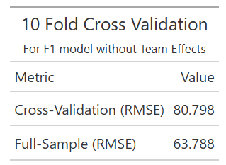
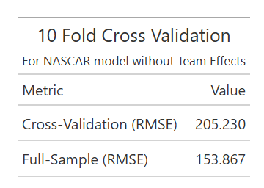
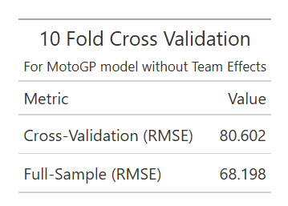
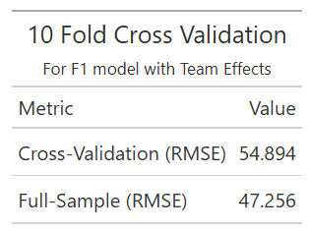
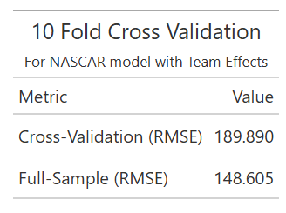
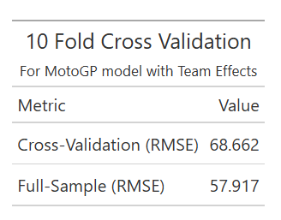
Models with team effects predicts success better than without
F1 model
NASCAR model
MotoGP model

Slide 10
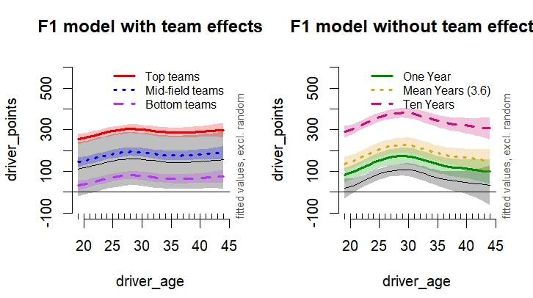
Notes:
Legends need to be added on all following graphs

Slide 11
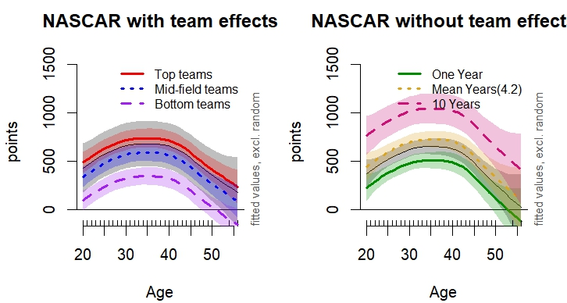
Notes:
Fix graph

Slide 12
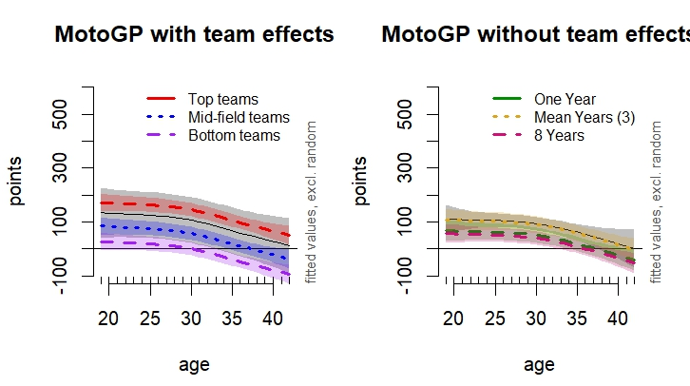

Slide 13
Discussion
The type of team a driver is on will have a greater impact on success then when not accounting for the team
The years a driver is at a team also significantly impacts his success
We see different peak ages in all three sports

Slide 14
References
Casanova S, Bulsink P (2025). _f1dataR: Access Formula 1 Data_.
doi:10.32614/CRAN.package.f1dataR <https://doi.org/10.32614/CRAN.package.f1dataR>.
R package version 2.0.1, <https://CRAN.R-project.org/package=f1dataR>.
Grealis K (2026). _nascaR.data: NASCAR Race Data_. R package version 3.0.0,
<https://www.kylegrealis.com/nascaR.data/>.
"MotoGP API." Pulse Live / Dorna Sports, 2026, https://api.motogp.pulselive.com/motogp/v1

